Slide 1


Slide 2
Hello hello, Human! I am so proud of you! We will make a better world together!
Now you will watch a small video about IoT - it is a summary about what it is. Pay attention: at the end of the this level, we will have a quiz, and if you do it well you you win gold bars!

Slide 3


Sit, relax and watch it!

Slide 4
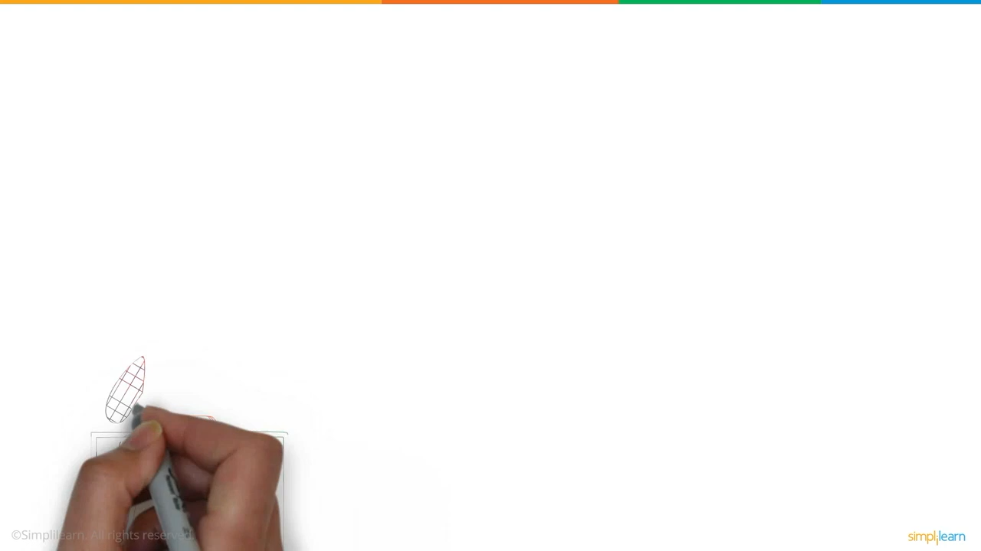

Slide 5

Great job, Human! You got more gold bars! With each step you are nearer to help the world!
See you in task 1.3. Bye!!
You receive 100 bars for finishing Task 1.2

